Slide 1

ICEG
REVIEW COMITE
09/02/2024

Slide 2
Welcome & agenda of the meeting

Slide 3
AGENDA
TOPIC | SPEAKER | TIMING
Welcome and agenda | Raf Buyle & Marc Bruyland | 14u00 – 14u05
STATUS TRAJECTORIES ICEG Building – formal accreditation ICEG Hydrants – status & next steps IMKL – status & next steps | Jitse De Cock Jitse De Cock Ivy Van De Kerchove | 14u05 – 14u10 14u10 – 14u20 14u20 – 14u35
ICEG OPPORTUNITIES 2024 BEST - need & approach ICEG Person – next steps PLANNING 2024 ICEG Training 2024 – needs and content | Eddy Corthouts – Evelyn Barreto Liesbet Dhondt - Mathieu Tulpinck Review committee Digitaal Vlaanderen | 14u20 – 14u30 14u30 – 14u40 14u40 – 14u50 14u50 - 15u00
ICEG Management Committee 03/04 Budget 2024 Next Steps | Marc Bruyland – Raf Buyle | 15u00 – 16u00

Slide 4
STATUS of the ICEG trajectories

Slide 5
ICEG BUILDING – formal accreditation (Jitse De Cock - 5')

Slide 6

Scope of ICEG building
Existing use cases from the Charter
Additional use cases from the business workshop
Building units are addressable objects
Building (units) have a unique identifier and a link with both the population register and the cadaster
Create a link between the following registers; parcels, buildings, building units and addresses
A building / building unit has an entrance location and some indoor navigation instructions
Create a link between a building and his quality criteria
Every building (unit) has a specific function (f.e. Police station, fire station, school, …)
Buildings and building units consists of 2D and 3D information
Every building (unit) has a lifecycle
A building is linked with the official registration of buildings (building register)
Scope

Slide 7
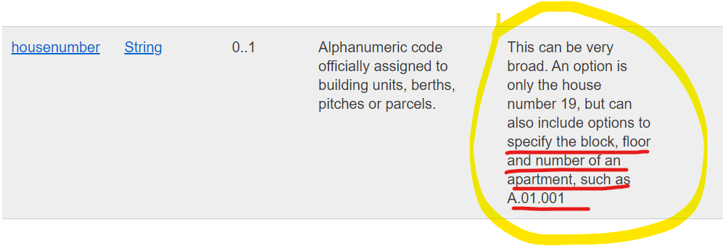
Status
Alignment with INSPIRE is crucial
Model was validated by the INSPIRE committee with a minor comment on ‘Address representation’

Slide 8
Changes
Usage note was partially removed from housenumber
Additional usage note for box number indicating what is advised to (not) be captured under this attribute.
Additional usage note for the class ‘Address representation’ refering to BeST as a reference for alignment for concrete implementations for Belgian addresses.
Cardinality for entrance location for ‘Building unit’ lifted from 1..* to 0..* to align with other attributes and data requirements.

Slide 9
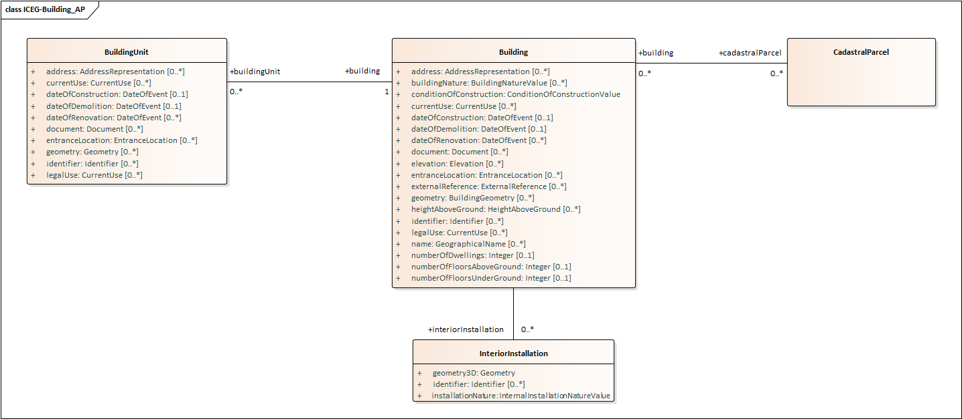
Model
Stable since September 2023, with minor editorial fixes in February
Available via GitHub here.
Core of the model:

Slide 10
Accreditation
Received INSPIRE Committee validation
Specification is ready to be put forward for official accreditation by the ICEG Review comité

Slide 11
ICEG HYDRANTS – status & next steps (Jitse De Cock – 10')

Slide 12
Context
Water companies were not willing to validate the current model without further alignment between the firefighters and themselves
Need to disentangle the semantic model and implementation (i.e. data exchange scenarios)
Separation of concerns
Need on overview of data requirements on both sides

Slide 13
Status
ICEG Hydrants has been kick-started again
Roadmap for 2024 has been verified by NGI & FOD BOSA.
All stakeholders have been informed about the approach for 2024 and the objective has been clarified once more.

Slide 14
Roadmap
Date | Event
22/02/2024 | A physical working group at FOD BOSA with the water companies and representatives from the firefighters, to further elaborate on the needs for the data model
28/03/2024 | A two-hour workshop to address outstanding issues with all stakeholders
25/04/2024 | A closing workshop will be held to validate the specifications
May 2024 | GO for formal accreditation

Slide 15
IMKL – status & next steps (Ivy Van De Kerchove – 15')

Slide 16











IMKL-update Context & ambitions
2023
2024 - 2025
Implementation of new validation rules IMKL 3.0
Analysis data model
IMKL 3.0 will become a Flemish OSLO data standard
Brussels and Wallonia also aim to mandate the exchange of vector data
Goal: to turn the Flemish data standard into a national standard
Supported by ICEG
Notes:
IMKL is ontwikkeld in 2016 voor de volledige digitalisering van het KLIP.
Gebaseerd op Europese standaard ‘INSPIRE Utlity Services’, met extra toevoeging van classificaties, attributen en relatief in functie van ondergrondse kabels en leidingen.
Meest recente versie in productie sinds 2017. Sindsdien breaking changes Inspire, internationale richtlijnen vanuit OGC, nieuwe use cases zoals beleidsvoorbereidingen, maar ook nood om Lambert 2008 toe te laten ipv Lambert 1972.
IMKL 3.0 wordt een Vlaamse OSLO-data standaard → dit gaat enkel over de semantiek van de relaties & begrippen. De implementatie zal in XML gebeuren.
In Vlaanderen zullen in 2024 de validatieregels geschreven worden voor het vernieuwde model, met effectieve toepassing van IMKL 3.0 in KLIP in 2025.
Brussel & Wallonië werken ook aan een implementatie vanaf 2025.
Doel om het samenwerkingsakkoord met de andere gewesten in Q1 2024 rond te krijgen en te laten ondertekenen voor de nieuwe legislaturen starten na de verkiezingen.
ICEG is het comité dat de samenwerking rond de opmaak en het onderhoud van interfederale standaarden faciliteert.

Slide 17


Proposed planning release IMKL 3.0
KLIP
KLIM
Brussels Capital Region
2024
2025
2026
2027
2028
Walloon Region
Developments for release IMKL 3.0 datamodel
Transition period for users
April ’28: decretal obligation
Developments towards transitioning to vectorized exchange
Transition period for users
IMKL 3.0 datamodel available
IMKL 3.0 mandatory for users
IMKL 3.0 mandatory for users
Cooperation agreement signed
Aug ’25:
KLIM-CICC & KLIP platforms ready IMKL 3.0
Ordinances for obligation vectorial exchange in Brussels and Wallonia signed
Network administrators must have data available in Lambert 2008 by the time the statutory obligation applies
Transition period for national stakeholders
Notes:
Timings in accordance with KLIM, Bruxelles & Wallonia
This year’s focus:
Flanders further development of IMKL implementation model (practical use / code)
KLIM: modifications on platform in order to allow vectorized exchange
2025: both KLIP & KLIM ready for IMKL 3,0
Question on timings & dependency on ordinances (cfr. slide further on)
Cooperation agreement

Slide 18


Goal of the IMKL cooperation agreement
Point of view: we are “x” years ahead in time and IMKL 3.X is in use.
We are working together with all Belgian regions on
maintenance of the federal IMKL 3.X model.
Therefore, we are in need of an agreement which states:
How we will be organized
How changes on the model will be financed
And this within a legal set-up.

Slide 19




Set-up of the IMKL cooperation agreement
Project governance
Financial agreements
Legal
set-up
Validated within ICEG governance
Notes:
Legal framework (ICEG-format) with general agreements that are important when concluding a contract between different parties
To be validated by legal departments from the different regions
Validated within ICEG Governance
Heeft de vorm van een contract, ICEG-format

Slide 20


Governance
(Yearly) workgroup in September
Participation as delegate of sector/company/government/…
Modifications on the model
Through scenarios
A: Minor Changes (decisionmaking: workgroup)
B: Major Changes (decisionmaking: steering committee)
C: Entirely new iteration (decisionmaking: steering committee)
Costs are divided through distribution key as provided by ICEG
No central financing needed

Slide 21




Timeline & ambitions on the IMKL cooperation agreement
Initiation
Validation
Q4 2023: First modifications by legal service Digitaal Vlaanderen
Q1 2024: in coordination of ICEG
Execution
Q3 2023: Draft document on cooperation agreement initiated by Flanders
Validation by legal services of all other concerned parties
Consultation meetings between regions
Ambition: signed in Q3/Q4 2024
Validation by ICEG Management committee: 3/4/2024
1st meeting: 16/1/2024
2nd meeting: 20/2/2024

Slide 22
Questions for the ICEG review committee
Does choice of KLIM for IMKL overrule legal statement where no defined datamodel? How are end-users obliged to use IMKL if no legal statement (yet)?
What if one region/party is hicking behind in legal obligation for platform and data model?
Which are the relevant parties for this contract? Governments who are responsible for legislation and/or those responsible for digitalization? Who are the correct contact persons?
Involvement German speaking community (culture versus authority)?
Effect of concerned parties on distribution key?
Notes:
Essentie:
Uitklaring betrokken partijen: overheden bevoegd voor de wettelijke verplichting rond vectoriële uitwisseling versus overheden bevoegd voor digitalisatie?
Afhankelijkheid wettelijke verplichting versus keuze voor wélk datamodel? Zelfs als KLIM voor IMKL kiest, hoe hebben we dan garantie dat de KLB’s hetzelfde formaat (moeten) gebruiken? Cfr. Vlaanderen: in ministerieel besluit vastgelegd welke versie van IMKL.
KLIM heeft al contact gelegd met min. Collignon (Wallonië) met vraag KLIM asap aan te duiden als bevoegd platform
Hoe kunnen wij escaleren om mee samen druk te zetten? Vanuit management Dig VL / athumi en/of ICEG??
Wat willen we:
Sturing, beslissingen, actie!
As is legal obligation:
Flanders → obliged AND even stated which version of IMKL shoud be used.
Felderal → obliged through gass law for FETRAPI members
Brussels says all is ready to be signed
Wallonia is hicking behind → legislation towards 2028 is in order, but they need to assign IMKL/KLIM

Slide 23
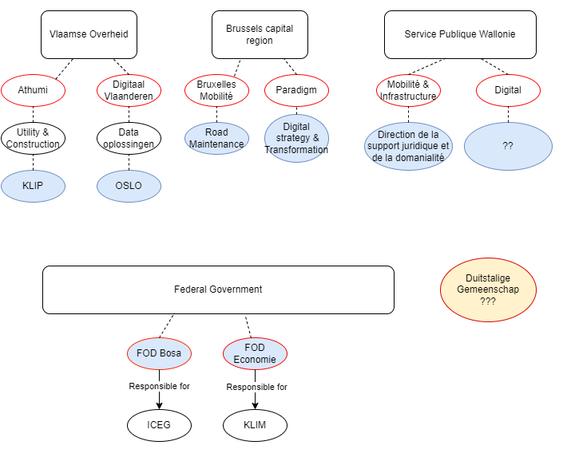
PROPOSITION
First idea/inventory of involved parties → to be confirmed??

Slide 24
Project Governance
Workgroup IMKL
1x a year in September or at the request of a member
On demand
by workgroup
ICEG Steering committee IMKL
DEMAND
SUPPLY
Project team
OSLO-team
in association with KLIP-team
Action after ‘Go’ workgroup / steering committee
Notes:
Informatief achter de hand te houden

Slide 25
ICEG Opportunities & questions

Slide 26
BEST ADDRESS (Eddy Corthouts & Evelyn Barreto – 10')

Slide 27
BeSt: Objective
BeSt stands for “Belgian Streets”.
The objective of the BeSt project is to provide address information on a national level based on the three regional address master data sets from Brussels, Flanders and Wallonia.
Cooperation between regions and federal government organisations (samenwerkingsakkoord/accord de cooperation”)
BeSt provides information about the following objects:
Municipality
partOfMunicipality (only Wallonia)
streetName
Address
postalInfo

Slide 28
BeSt: Stakeholders
Partners of the cooperation agreement
The National Geographic Institute (NGI)
The General Administration of the Patrimony Documentation (AAPD) from the FPS Finance
The National Registry (NR) from the FPS Internal Affairs
Statistics Belgium from the FPS Economy
The Crossroad Bank for Enterprises (CBE) from the FPS Economy
The Directorate general Security and Prevention from the FPS Internal Affairs
The FPS Governance and Support (BOSA)
The Agency for Administrative Rationalization (DAV)
The supplier of the universal postal services
The regions: Brussels, Flanders and Wallonia

Slide 29
Project Status

Slide 30
Project Objective
Via this initiative, the various stakeholders wish to document the standard for Belgian addresses on Github as was done for Building
This will be done based on the BeSt Address model, that can be considered a standard as it was defined by a large group of government organisations (federal + regional)
As the BeSt Address model has been developed already, there is no need for semantic workshops anymore.
Notes:
This was a conscious design decision:

Slide 31
Requested budget
A BOSA analyst will develop the required artifacts for Github
We would like to involve a PwC consultant for technical support
Requested budget: a maximum of 3 days PwC support
EUR 4.050,00
Time & Means, will only be used if needed

Slide 32
5. Q&A
?

Slide 33
ICEG Person (Liesbet Dhondt - Mathieu Tulpinck – 10')

Slide 34
Important to clarify with stakeholders purpose of ICEG traject.
The work on ICEG Person identified a number of needs:
Need for a generic ICEG vocabulary (temporal references,…)
Need for address layer above BeSt in order to capture unstructured or semi-structured address / location data. Belgian public service will usually want to make a distinction between domestic, European and third-country locations.
Need for a base registry model or at the very least a person registry model. Modeling these data points (historic versioning, traceability on multiple dimensions,…) requires its own follow-up traject.
Hooks for legal data points not yet present in ICEG Person (OSLO Persoon).

Slide 35
Generic vocab
This covers generic constructs like temporal and spatial concepts. This need has so far been tackled by ad hoc insertions in thematic vocabularies. For example, http://vocab.belgif.be/ns/building#DateOfEvent
Proposal: it might be preferable to properly address this need in a separate transversal namespace. http://vocab.belgif.be/ns/generic#

Slide 36
2. Address
There is a federal standard on address data: BeSt. This standard does not include an interface to exchange less structured data (either historic Belgian data not recorded in BeSt format or foreign addresses).
Proposal: refine http://vocab.belgif.be/ns/location# to include necessary concepts. Cf. eap file for rough draft.

Slide 37
3. Registry data
A lot of data currently in RR legal ITs is what can be described as registry data. We suggest to model it separately from the underlying person data. Registry data is actually not specific to person registries and is shared across all authentic sources (address registry,…). It should reflect the dynamic side of the underlying data.
Proposal: consider the opening of a follow-up traject on registry data. Cf. eap file for rough draft.

Slide 38
4. Person
Regarding underlying person data, the main issue is on a number of legal data points which are not yet present in ICEG Person.
E.g. a working right is an abstract prerogative of a person which is not linked to a particular company or organisation.
Efforts are ongoing on how to capture these data points.

Slide 39
ICEG Planning 2024 (Eveline Vlassenroot – 5')

Slide 40
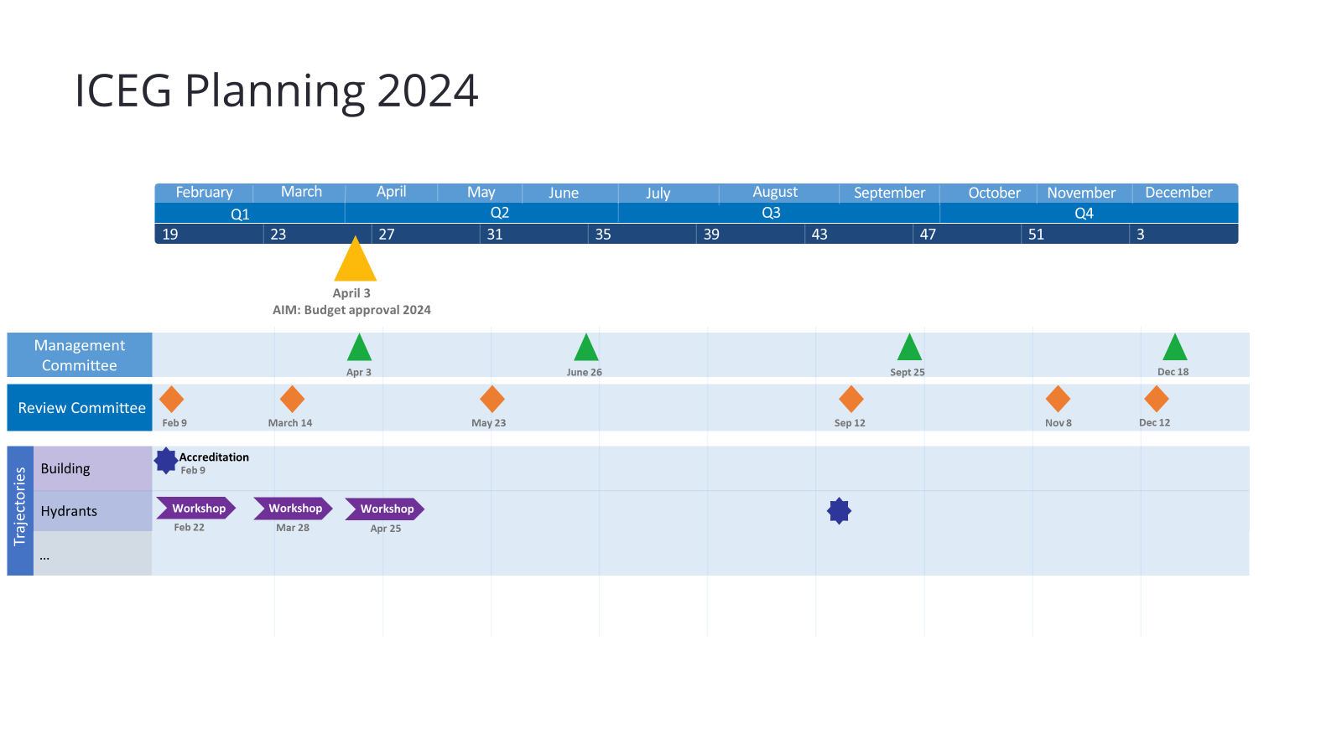
PLANNING 2024 (TBC)

Slide 41
ICEG Training – needs and content (Eveline Vlassenroot – 10')

Slide 42

ICEG Training Interoperability 2024
No new date for this year
4/12/2020 - 82 participants
13/06/2022 - 114 participants
Added value: awareness + leads to new exercises
Options for organizing training in 2024:
Recap of training 2022: effort from all parties to facilitate training
Update of training with new case: extra budget needed
Possible next steps:
Set date for training
Organise meeting to prepare

Slide 43
ICEG Management Committee 03/04/2024

Slide 44
Budget 2024
Next meeting (probably EoY) we will prepare the new budget to finance the activities in 2024
an ICEG budget such as the “2022” budget for development of data standards (e.g. 150.000 €).
an additional budget for the translation of the Data Standards (e.g. 150.000 €).
We propose the same distribution key (2022).
Deelnemende partij | Gevraagde budget 2024 (EUR) | aandeel (%) | vertegenwoordiger
Federale overheid | 80.000 | 26,67% | BOSA FOD Beleid & Ondersteuning
Vlaamse gemeenschap | 80.000 | 26,67% | Digitaal Vlaanderen
La Région wallonne | 50.000 | 16,67% | Service Public de Wallonie (SPW)
Région de Bruxelles-Capitale, Brussels Hoofdstedelijk Gewest | 20.000 | 6,67% | Paradigm
Fédération Wallonie-Bruxelles | 50.000 | 16,67% | ETNIC
Deutschsprachige Gemeinschaft | 20.000 | 6,56% | DUG
TOTAL | 300.000 | 100%

Slide 45

Thank you for your attention
Any questions?
Notes:
Verschillende opties als tussenslide

